Slide 1
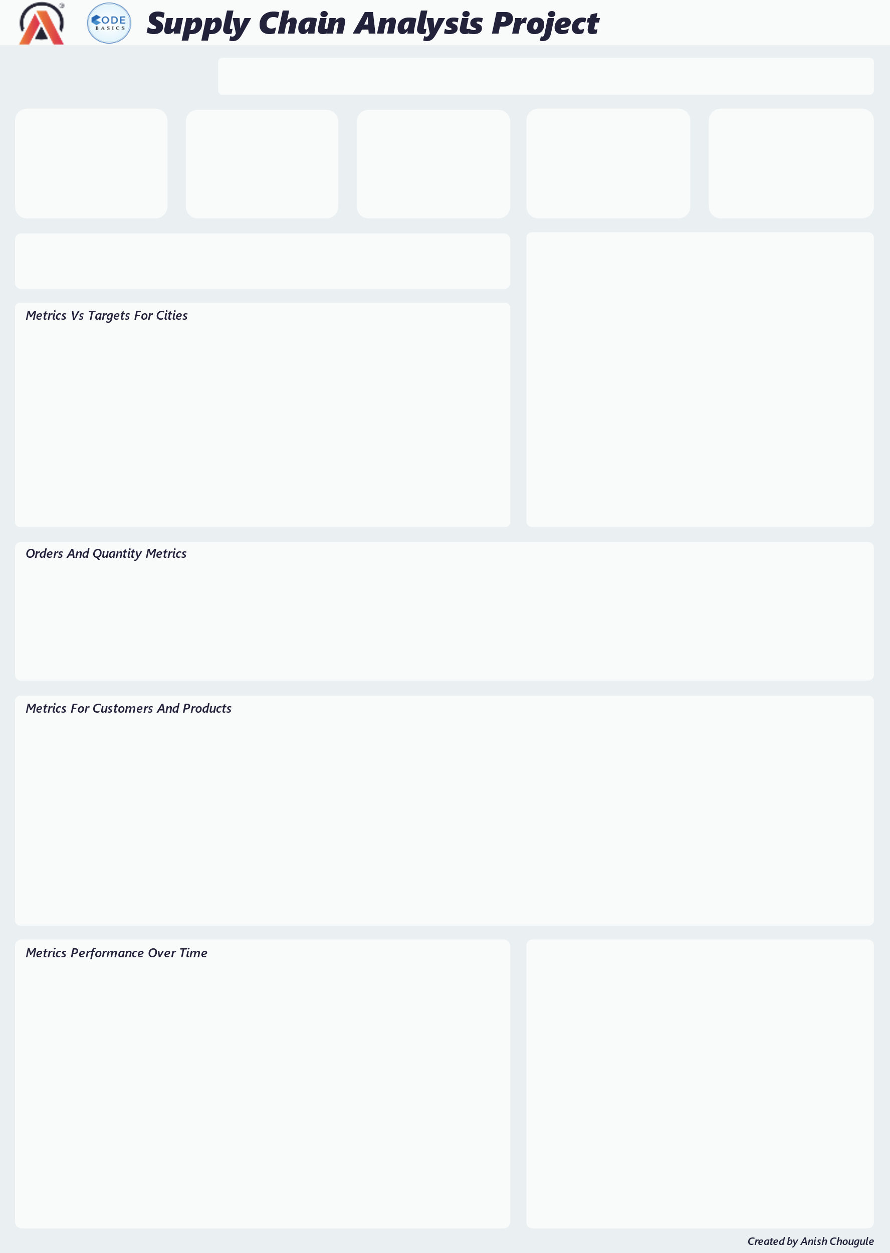

Slide 2
Notes
MoM – Month-over-month change
DoD – Day over-day change
OTIF – On Time In Full
IF – In Full
OT – On Time
LOFR – Line Fill Rate
VOFR – Volume Fill Rate
Because the fluctuations are so small, the Y-axis on the line graph does not begin at 0.
Insights
Key performance indicators like On Time In Full, In Full, and On Time don't meet the goals over time.
Surat has a lower In full% than Ahmedabad but has a 30% OTIF rate. Out of 9.7k orders, 3.7k are delayed orders and 4.6k were incomplete orders. Acclaimed stores, info stores, and Lotus Mart were the customers who performed very low on key metrics in Surat. OTIF levels of 9% and 6% for info stores and acclaimed stores need critical attention.
Ahmedabad accounted for 11k orders and has a 29% OTIF with a greater In Full rate than other cities. In terms of critical metrics, Lotus Mart, Sorefoz Mart, Acclaimed Stores, and Coolblue were the customers who performed very low in Ahmedabad. OTIF levels of 10% and 7% for Lotus Mart and Sorefoz Mart need critical attention.
Vadodara has 27% OTIF deliveries and performs worse than other cities. Coolblue, Elite Mart, Vijay Stores, Lotus Mart, and Acclaimed Stores were the customers who had very low levels for important metrics. OTIF levels of 10%, 9%, and 7%, for Coolblue, Elite Mart, and Vijay Stores need critical attention.
The key customers, who account for 50% of the orders, are Lotus Mart, Acclaimed Stores, Coolblue, Vijay Stores, Propeller Mart, and Rel Fresh. The customers most likely to not renew their contracts are Lotus Mart, Acclaimed Stores, and Coolblue. Vijay Stores, Propeller Mart, and Rel Fresh are the next most likely to do so. Lotus Mart, Acclaimed Stores, and Coolblue have the lowest Otif%. The average delay for these customers was 30 hours for 6.8k delayed orders out of 9.5k total orders, and 4.6k orders were incomplete out of 9.5k total orders.

